Slide 1
CHAPTER 3
DERIVATIVES

Slide 2
CONTENTS
3.1. Derivatives
3.2. Derivative as a Function
3.3. Differentiation Formulae
3.4. Rates of Change in the Natural and Social Sciences
3.5. Derivatives of Trigonometric Functions
3.6. The Chain Rule
3.7. Implicit Differentiation
3.8. Derivatives of Logarithmic Functions
3.9. Related Rates
3.10. Linear Approximations and Differentials

Slide 3
3.6. THE CHAIN RULE
3.6.1. The Chain Rule
3.6.2. Proof of the General Power Rule
3.6.3. The Power Rule combined with the Chain Rule
3.6.4. Tangent to Parametric Curves
3.6.5. Proof of the Chain Rule

Slide 4
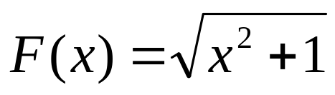
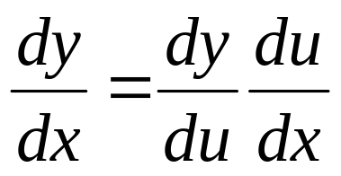
3.6.1 The Chain Rule
Suppose we want to compute the derivative of
Then observe that F can be written as the composition
Notice that dy/du is the rate of change of y with respect to u and du/dx as that of u with respect to x.
So dy/dx is precisely the rate of change of y with respect to x. Hence we expect to have

Slide 5
The Chain Rule. If f and g are both differentiable, then F=f o g is differentiable and
F’(x) = f ’(g(x)) g’(x)
Or in Leibniz notation

Slide 6
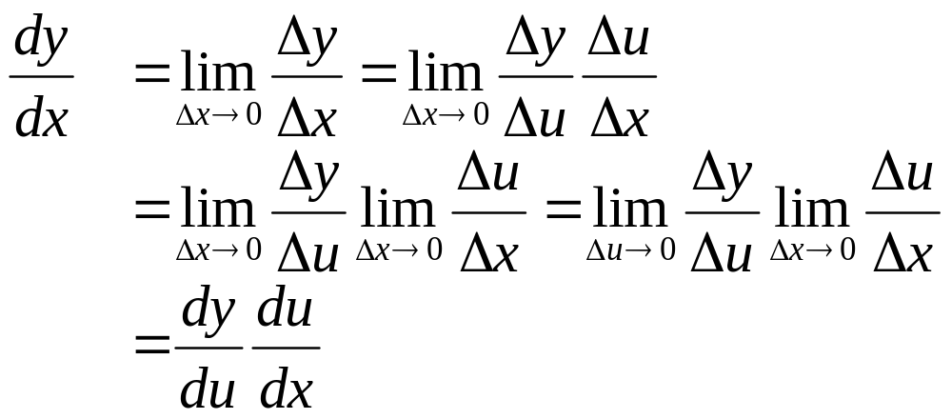
Simple Proof. Let Δx be a small change of x then
Δu=g(x+Δx) – g(x)
and Δy=f(u+Δu) – f(u)
Hence we have
However the foregoing proof is incorrect since Δu may vanish even though Δx ≠ 0

Slide 7
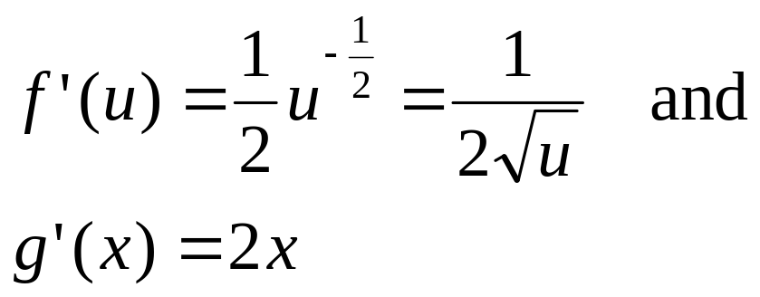
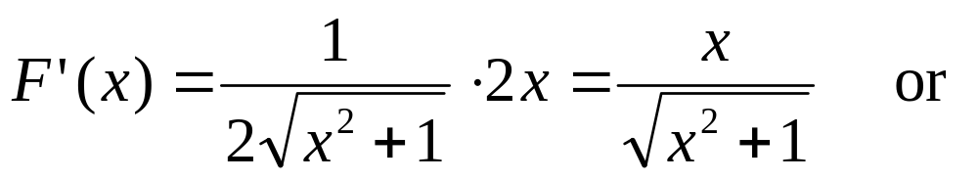
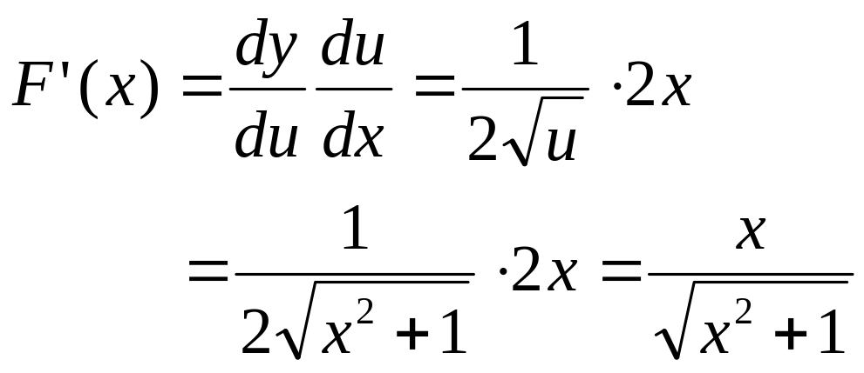
Example. Find F’(x) if
Solution. Then
By the Chain Rule we have

Slide 8
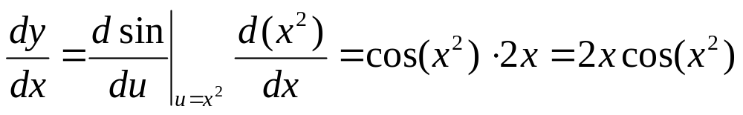
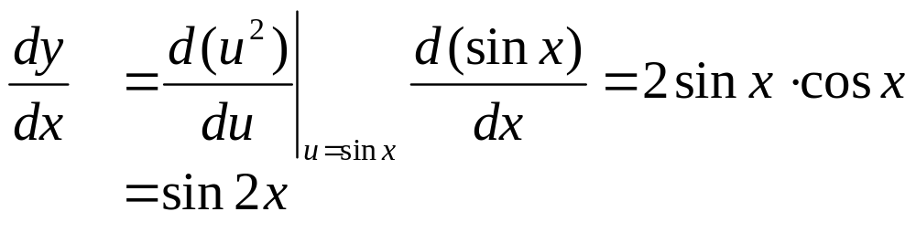
Example. Differentiate (a) y=sinx² (b) y=sin²x
Solution.
(a)
(b)

Slide 9
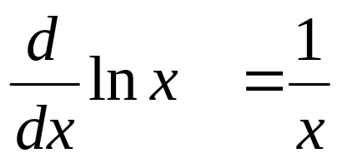
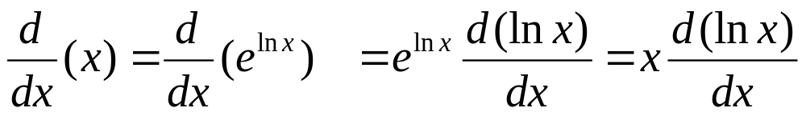
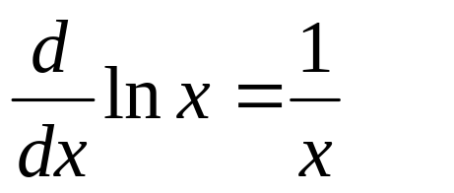
Theorem.
Proof. Note that e^{lnx} = x
Hence the Chain Rule gives
Therefore

Slide 10
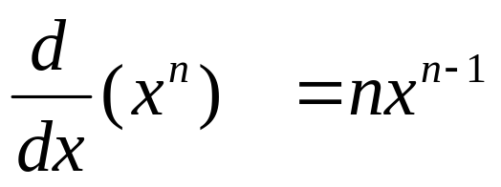
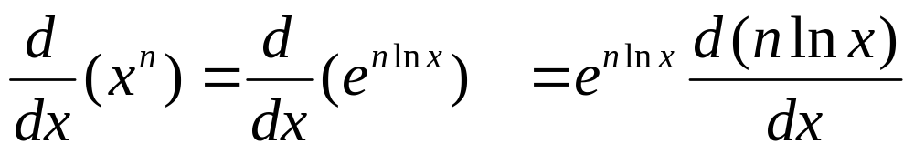
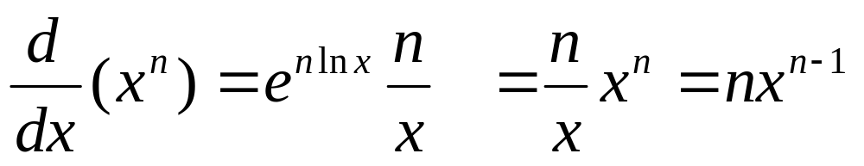
3.6.2. Proof of the General Power Rule
Theorem. If n is any real number, then
Proof. The Chain Rule gives
Since
We have

Slide 11
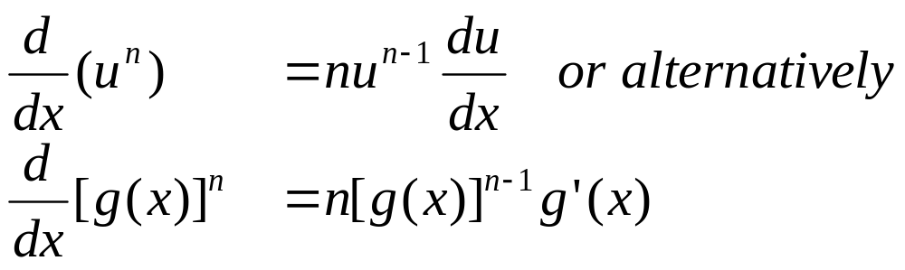
3.6.3 The Power Rule combined with the Chain Rule
Theorem. If n is any real number and u=g(x) is differentiable, then

Slide 12
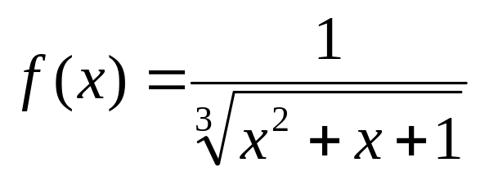
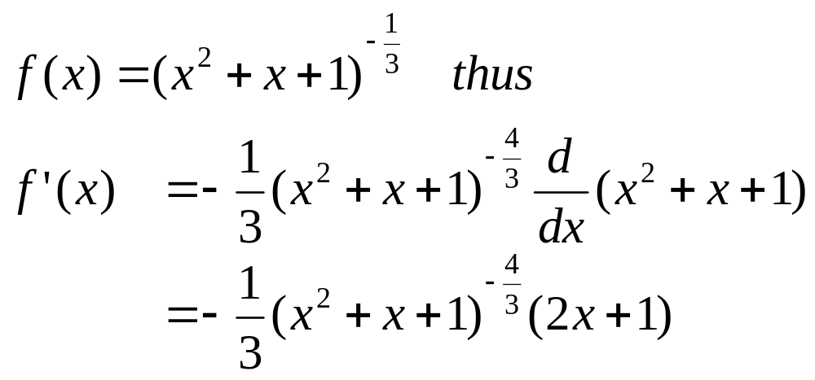
Example. find f’(x) if
Solution. We write

Slide 13
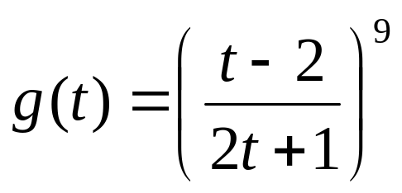
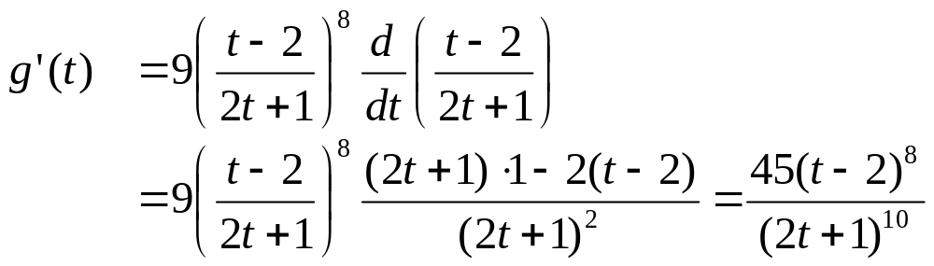
Example. find g’(t) if
Solution. Combining the Power Rule, the Chain Rule and the Quotient Rule we get

Slide 14
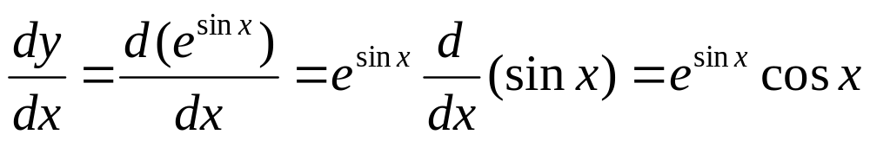
Example. Differentiate y = e ^{sin x}
Solution. We have

Slide 15
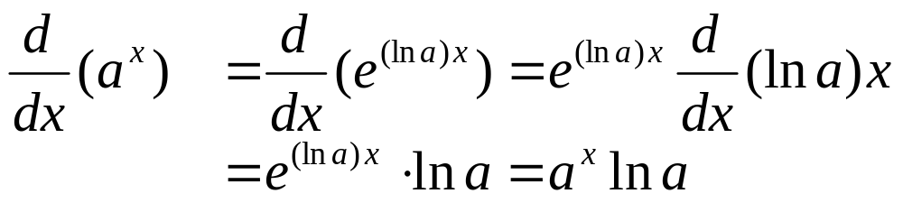
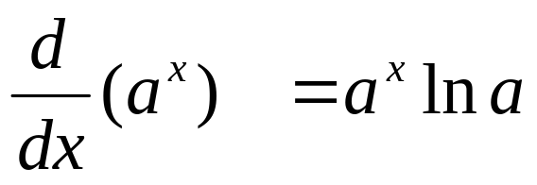
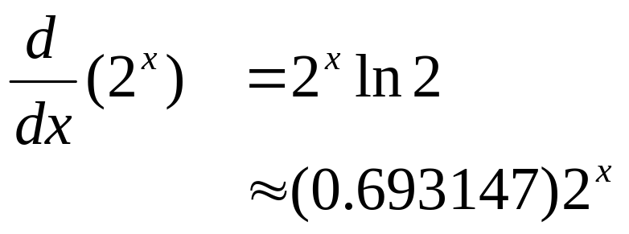
Using a^{x} = (e ^{ln a})^{x} = e ^{(ln a) x} we have
Hence
Example.

Slide 16
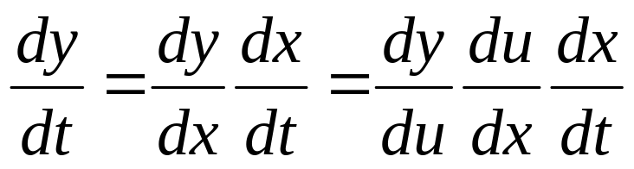
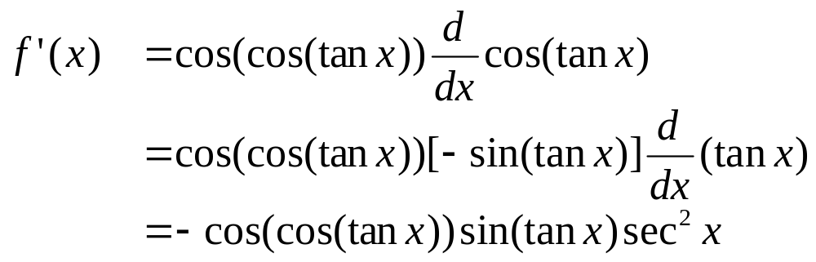
Remark. We can apply the Chain Rule for the composition of several functions, e.g. let y=f(u), u=g(x) and x=h(t) be differentiable then
Example. If f(x)=sin(cos(tan x)), then

Slide 17
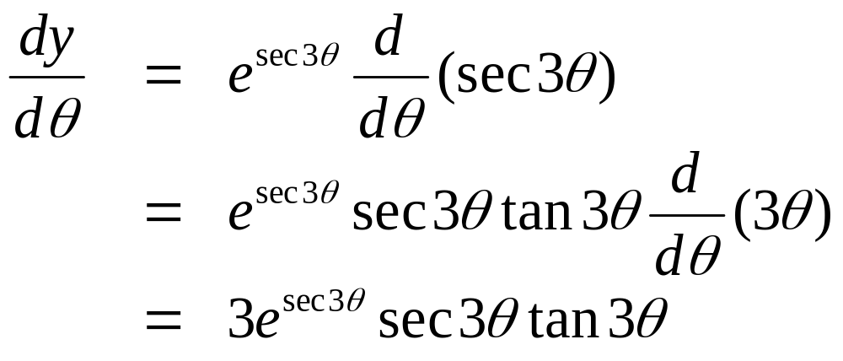
Example. Differentiate y = e ^{sec 3θ}
Solution. We have

Slide 18
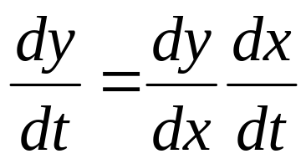
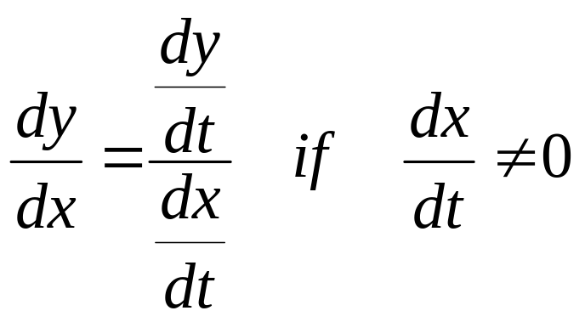
3.6.4 Tangents to Parametric Curves
Consider a parametric curve defined by
x = f(t), y = g(t)
Applying the Chain Rule we get
The slope of the tangent at the point (f(t), g(t)) is
(7)

Slide 19
If the curve is traced out by a moving particle, then dx/dt and dy/dt are horizontal and vertical velocities of the particle the quotient of which are precisely the slope of the tangent of the curve
The curve has a horizontal tangent if dy/dt = 0 provided dx/dt ≠ 0
The curve has a vertical tangent if dx/dt = 0 provided dy/dt ≠ 0

Slide 20
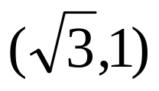
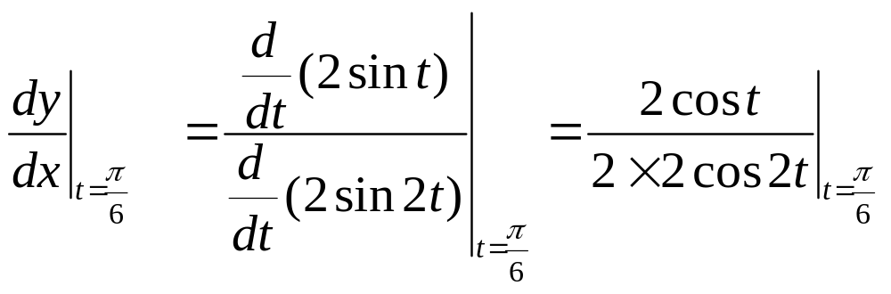
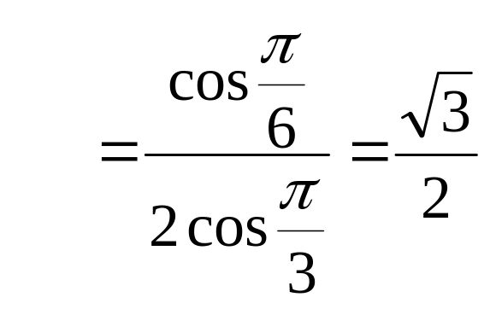
Example. Find an equation of the tangent to the parametric curve
x = 2 sin 2t y = 2sin t
at the point
Solution. The point corresponds to t = π/6, so the slope of the tangent at that point is

Slide 21
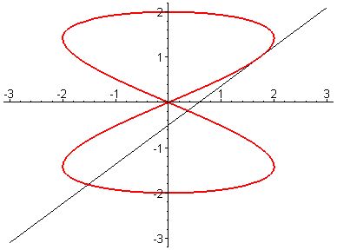
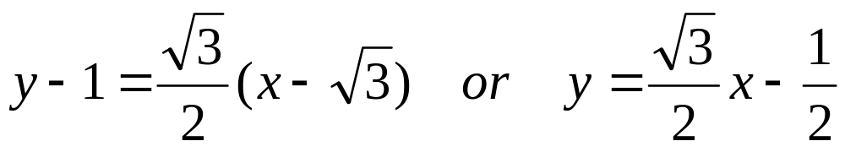
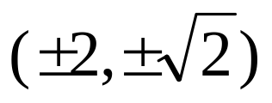
An equation of the tangent line is
The tangent line is horizontal when cost = 0 and cos2t ≠ 0, i.e. when t=π/2 and t=3π/2 which corresponds to the points (0,2) and (0,-2)
The tangent line is vertical when cos 2t = 0 and cost ≠ 0, i.e. when t=π/4, 3π/4, 5π/4 and 7π/2 which corresponds to the points

Slide 22
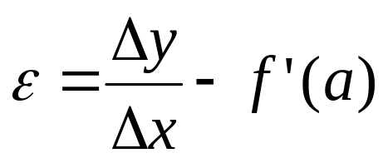
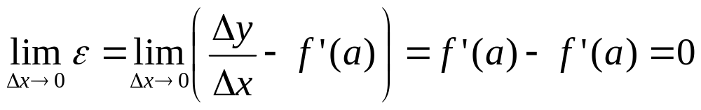
3.6.5. PROOF of the CHAIN RULE
Lemma . If y=f(x) is differentiable, then
Δy = f'(a) Δx + ε Δx
where ε → 0 as Δx → 0
Proof. Put then

Slide 23
Proof of the Chain Rule. Let u=g(x) be differentiable at a and y=f(u) differentiable at b=g(a) then for any increment Δx, the corresponding increments satisfy
(1)Δu = g'(a) Δx + ε₁ Δx = [g'(a) + ε₁]Δx
where ε₁ → 0 as Δx → 0, and
(2)Δy = f'(b) Δu + ε₂ Δu = [f'(b) + ε₂]Δu
where ε₂ → 0 as Δu → 0. Substitute (1) in (2) we get

Slide 24
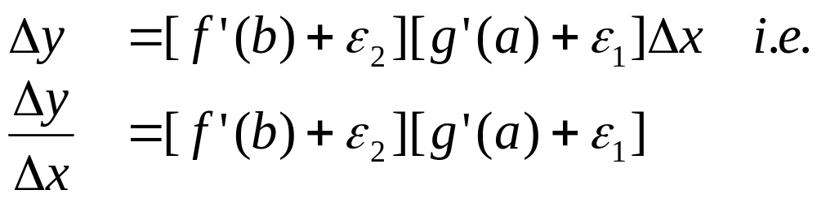
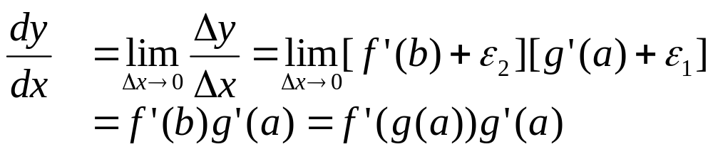
Proof of the Chain Rule (contd). Substitute (1) in (2) we get
As Δx → 0, (1) shows that Δu → 0, so both ε₁ → 0 and ε₂ → 0, and

